Slide 1
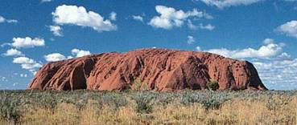
Aboriginal Art

Slide 2
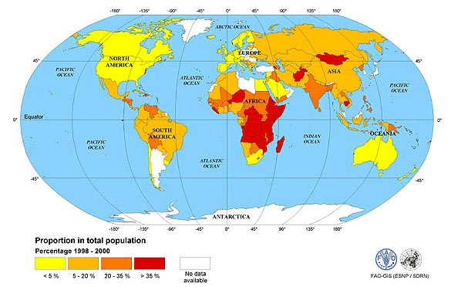
Where is Australia?

Slide 3
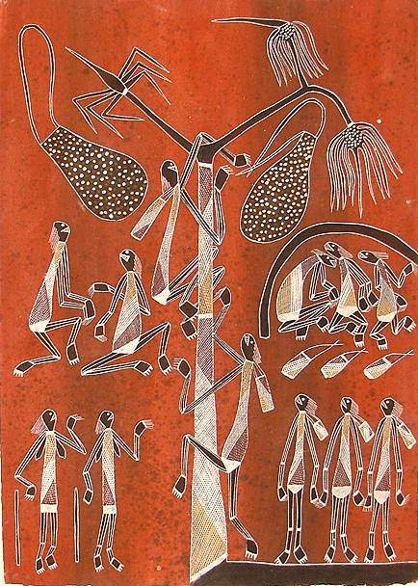
Aboriginal paintings include humans, plants and animal figures
Art, Land & The Dreaming
!

Slide 4
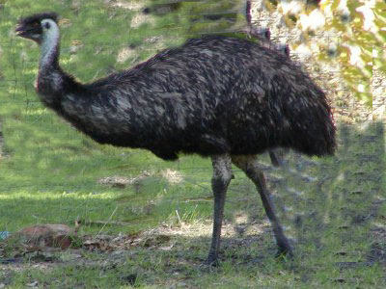
There are many Emu birds in Australia

Slide 5
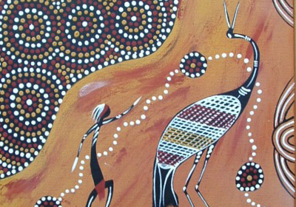

Slide 6
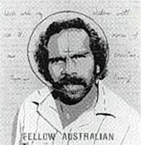
Aboriginal People
They are indigenous Australians
They tell stories about how the world began.They call this Dreamtime
Their stories are called Dreamings

Slide 7
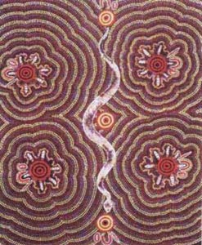
Aboriginal Paintings
This painting is called Witchetty Grub Dreaming by Mary Dixon Nungurrayi.
A witchetty grub is a kind of caterpillar that Aboriginal people traditionally eat.
lick on the picture to take a closer look

Slide 8
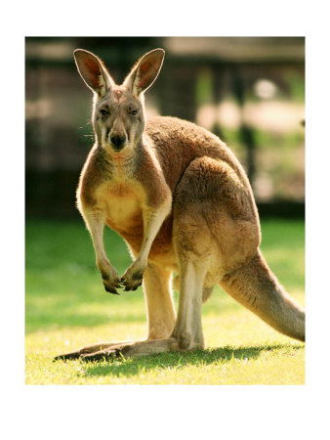
Kangaroo

Slide 9
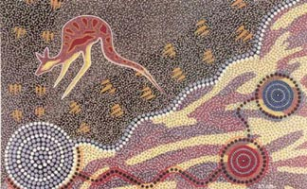
This painting is Journey of the Koori by Ron Potter. What do you think a Koori is?
It’s a kangaroo

Slide 10
Aboriginal paintings use earth colours
Why?
These are the colours of the desert. Aboriginal artists made their paints from natural materials.

Slide 11
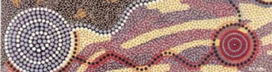
Aboriginal paintings are also often made up of dots
Why?
What did Aboriginal Artists paint with in the desert?
They used their fingers or sticks.

Slide 12
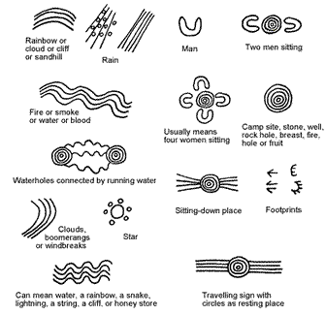

Slide 13
For Today
Aims
Understand symbolism behind Aboriginal Art
Create your very own ABORIGINAL BOOKMARK
Objectives
Complete 4 self produced Aboriginal symbols from the list of words below to help tell a story about yourself:
Birth
Celebration
Favourite hobby
Pet
Family
Home
Friends
London

